Slide 1
Computer Science: What, and Why?

Slide 2
Robbert van Renesse

Slide 3
My Career Path in CS
I was born and grew up in Amsterdam
I liked building electronic stuff in high school
even built some small computers
Studied mathematics in university
but quickly specialized in programming
Became a “Research Assistant” to a computer science professor
Became a Ph.D. student
After my degree, I did a “postdoctorate” at Cornell University in the United States

Slide 4
Career cont’d
I worked for AT&T Bell Labs in 1990
Started a research position at Cornell in 1991
Co-founded two software development companies in late nineties
One sold to Microsoft, other to Amazon
Started another company last year with Prof. Weatherspoon
Also still a professor at Cornell

Slide 5
Hakim Weatherspoon

Slide 6
My Career Path in CS
I was born and grew up in United States
I liked math in high school
Studied computer engineering in university
Became a “Research Assistant” to a computer science professor
Became a Ph.D. student
Studied computer science in graduate school
After my degree, I did a “postdoctorate” at Cornell University in the United States

Slide 7

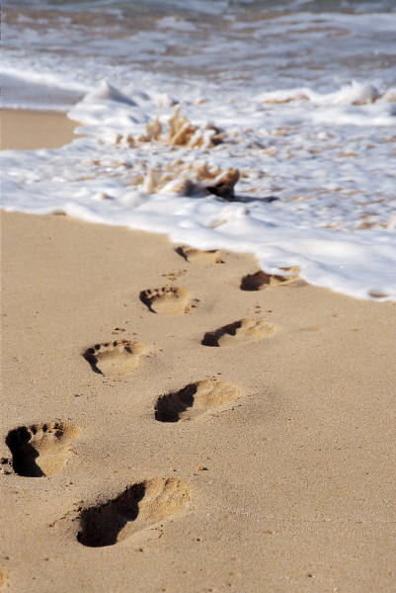
Career Cont.
Career looks like a straight path
High school → Undergrad→grad→post-doc→professor
But footsteps includes sharp turns
Played football as an undergrad
Thought about for grad school only after applied for Rhode Scholar
Married one year into grad school
Two kids year two and four
Post-doc help convince me of academic career
Recently started a company last year with Prof. van Renesse
Also still a professor at Cornell

Slide 8
My Career Path in CS
Assistant Professor, Cornell University
Since 2008
Postdoc 2006-2008
Graduate, University of California, Berkeley
Ph.D. in Computer Science, 2006
Thesis - Design and Evaluation of Distributed Wide-Area On-line Archival Storage Systems
Model and implement, and deploy an archival system that stores data in a global, durable, verifiable, and self-maintainable manner
Undergraduate, University of Washington
B.S. in Computer Engineering, 1999

Slide 9
Why Computer Science?

Slide 10
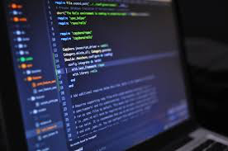
What is Computer Science?
Problem Solving using Computers
Many areas of CS:
Machine Learning and Artificial Intelligence (AI)
Data Science, Big Data
Theory and Algorithms
Programming Languages
Scientific Computing
Systems, Networking, and Databases
Security
Graphics
Architecture
Robotics
Computational Biology
Quantum Computing
Human Computer Interfacing
…
It’s not just programming!

Slide 11
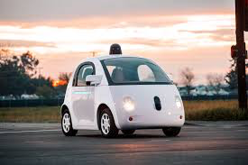
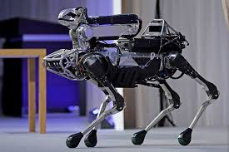
What is CS Used For?
Computers, Mobile Phones, etc.
Word processing, spreadsheets, etc.
Computer games, computer animation
Self-driving cars and trucks, robots, …
The “Web”
Apps and “The Cloud”
Google Search, Facebook, WhatsApp, Instagram, ...
Uber, Amazon, eBay, …
Blockchains and Cryptocurrencies
Smart home, smart farm, smart city, …
Air Traffic Control, Power Grid, etc.
Modern health care
much much more
What are your favorite computer apps?

Slide 12
Career Paths in CS
Become a programmer
specialize in robots, computer games, or …
Become a web designer
build nice web sites
Become a data analyst
collect data and figure out what it means
Become a systems/network/database administrator
maintains systems, email, computer networks, etc.
Become an entrepreneur
start a company (consulting, new tech, etc.)
Become a professor
come up with new uses for computers, and teach students about computer science
…

Slide 13
There are many high paying CS jobs out there!!
Almost every industry needs CS experts
Working with all kinds of people on all kinds of problems
International opportunities

Slide 14
Cornell University

Slide 15
Cornell: A Special View
Originally: Focus on qualitative innovations:
Hardware was getting faster, and qualitative properties only became more important
Subsequently: Add researchers who also engineer
Work is still principled; contributions are more about ideas than artifacts.
“Build first” [them] versus “Think first” [us]
Building first to discover the important problems
Building second to validate assumptions and thesis
Notes:
Early asynchronous consensus protocols done here long before Paxos. Famous lower bounds derived and proven here.
First formal characterization of safety and liveness properties. The notion of “fail-stop” failures originates here.

Slide 16
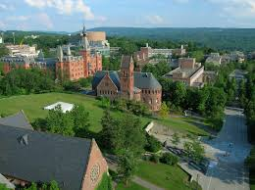
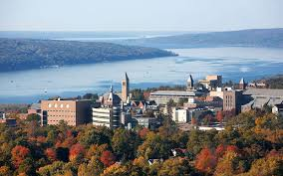
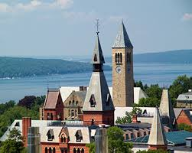
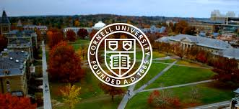
Cornell: very pretty!

Slide 17
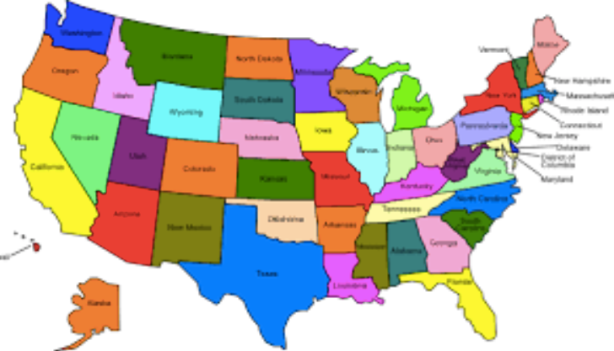
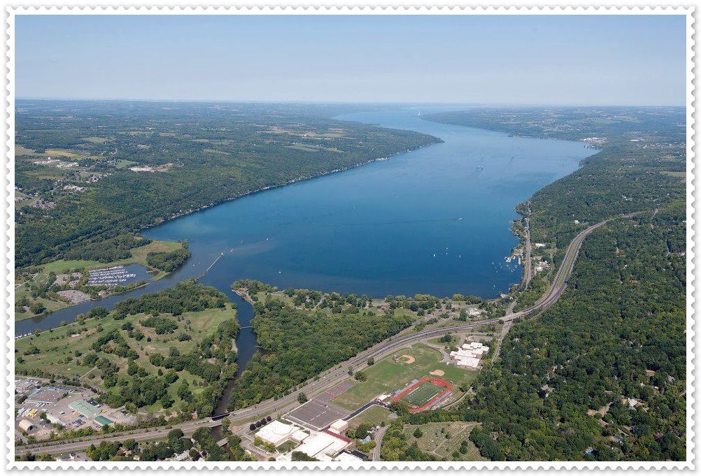
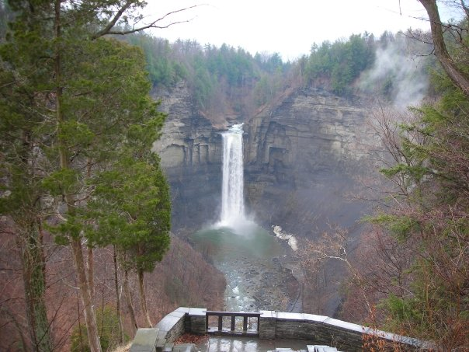
Ithaca
“Centrally Isolated”
4 hours from New York
4 hours from Toronto
3 hours from NIagara Falls
4 hours from Philadelphia
6 hours from Washington D.C.
6 hours from Boston

Slide 18
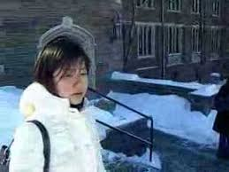
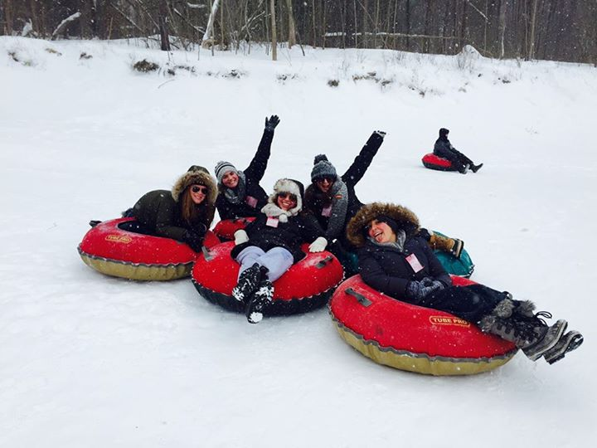
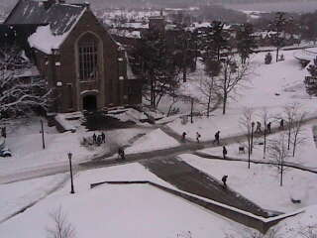
Ithaca Winter
Long and cold
Good for studying
Fun too!
Good for socializing!

Slide 19
Cornell Activities, Clubs, and Classes
sailing
windsurfing
canoeing
kayaking
scuba diving
downhill skiing
cross-country skiing
music
ice skating
rock climbing
hiking
camping
caving
dancing
wine-tasting
…

Slide 20
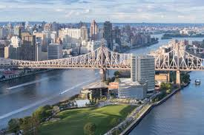
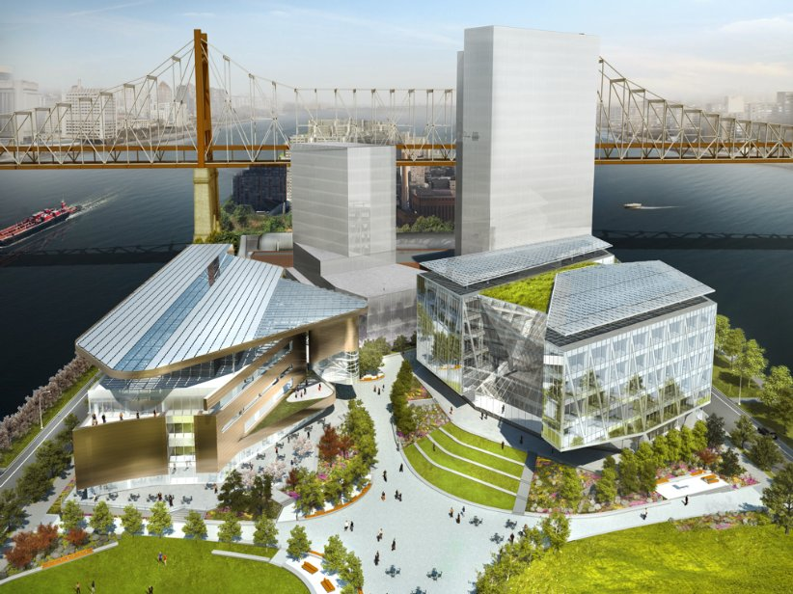
CornellTech in NYC
Silicon Alley
Emphasis on
entrepeneurship

Slide 21
More on Cornell Computer Science
Consistently ranked among top 6 in the U.S.
World-class research covering all of C.S.
About 70 excellent faculty in C.S. “field”
About 150 Ph.D. students in C.S. department
Field includes:
Electrical and Computer Engineering
Information Science
Applied Math
Mathematics,
Operations Research and Industrial Engineering
Mechanical and Aerospace Engineering
Computational Biology

Slide 22
Cornell C.S. areas of research
theory
programming languages
scientific computing
artificial intelligence
machine learning
computer graphics
systems and networking
distributed systems
security
databases
robotics
natural language processing
human computer interfaces
and much much more…

Slide 23
Summary
High impact
Highly collaborative
Well resourced
… an exciting place to be!

